Slide 1
PROJECT WORK - PHASE 1
(SECOND REVIEW)
Presented by,
Manjusha S 21Z317
Mydhili Nayaki R 21Z324
Shrinidhi S 21Z352
Swetha M 21Z362
Vedavarshini A 21Z368

Slide 2

AGENDA
Title
Problem Statement
Design and Implementation
System Architecture
Modules completed
Results - Performance Metrics

Slide 3

SOIL HEAT FLUX DYNAMICS MODELLING USING TEMPORAL DEEP LEARNING FOR DETERMINING PLANT ROOT ZONE TEMPERATURE

Slide 4
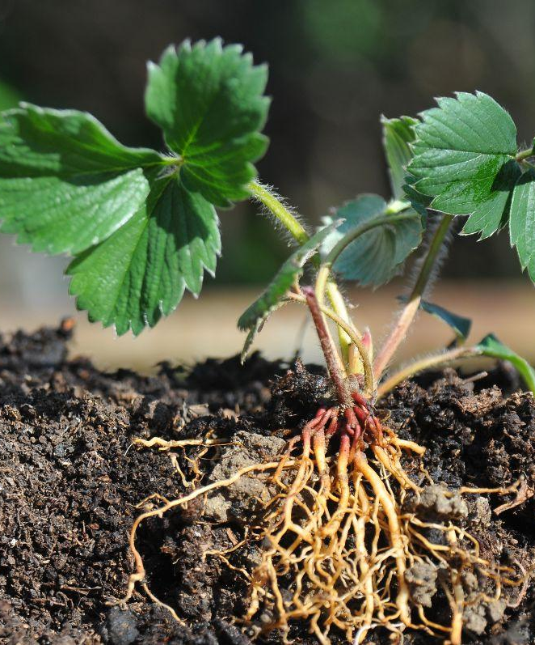
ABSTRACT
Aims to address the critical challenge of accurately predicting soil heat flux dynamics, which directly impact plant root zone temperature and overall agricultural productivity.
Employs Temporal Convolutional Networks (TCNs), a state-of-the-art deep learning architecture designed for temporal sequence data analysis.

Slide 5

PROBLEM STATEMENT
Productivity of Indian agriculture is often hampered by suboptimal soil temperature regulation, particularly in the root zone of plants.
Inadequate root zone temperature control can lead to poor plant health, reduced crop yields and increased vulnerability to pests and diseases.
Soil heat flux governs the transfer of energy within the soil.
Need for handling sequential data and capturing complex temporal patterns.

Slide 6
OBJECTIVE
By leveraging TCNs, this project aims to develop a robust predictive model that can dynamically forecast soil heat flux and optimize root zone temperature.
This advancement is expected to significantly improve agricultural productivity and sustainability in India, aligning with the nation's goals for food security and economic growth.

Slide 7
Design and Implementation - Progress until Review 1
425,262 entries and finding attributes types
Resampling the Time Series dataset in an interval of 1 hour to augment the number of data points in the training, testing, and validation sets.
10 columns have missing values , Contains extreme values like -9999, needs cleaning and entries are 0, should be deleted
Constant negative soil heat flux, with occasional sharp spikes to positive values.
Scale data using MinMax Scaler,drop columns with all zero values
Recommended features: Volume 20cm, Volume 10cm, Net Radiation, Conductivity, Soil Temperatures (10cm, 20cm, 80cm), DateTime/Month

Slide 8
Design and Implementation - Progress after Review 1
Resampling the Time Series dataset in an interval of 10 minutes to augment the number of data points in the training, testing, and validation sets.
Training the TCN model with the resampled dataset for multiple epochs like 10,25,50,75 and 100.
Analysing the performance of other existing models like ANN and LSTM for the same dataset for multiple epochs.
ANN model is found to have an accuracy of 93.56%
Development of an Ensemble model combining the strengths of Temporal Convolution Network (TCN) and Artificial Neural Network (ANN).
Ensemble model (TCN+ANN) is found to have an accuracy of 94.69%

Slide 9
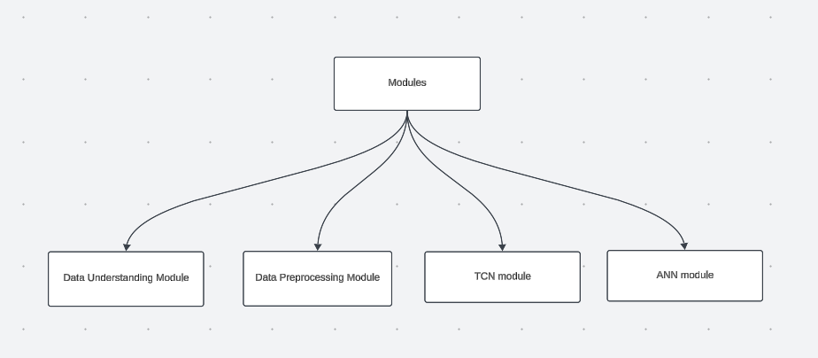
MODULES COMPLETED

Slide 10
SYSTEM ARCHITECTURE

Slide 11
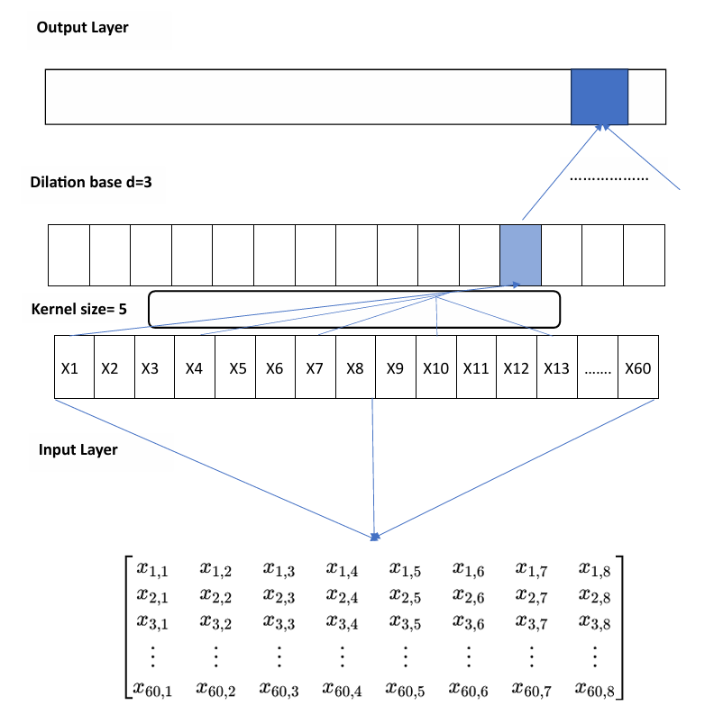
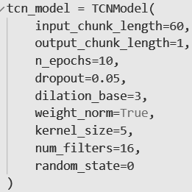
Architecture of TCN And ANN - Ensemble model
TCN
Architecture
(60,8)
input_chunk_length=60
Features=8

Slide 12
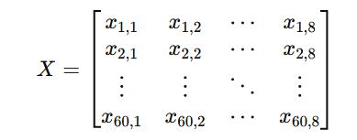



Mathematical representation of TCN
Input representation
2. Convolution Operation
3. Dropout Application
4. Output layer calculation

Slide 13
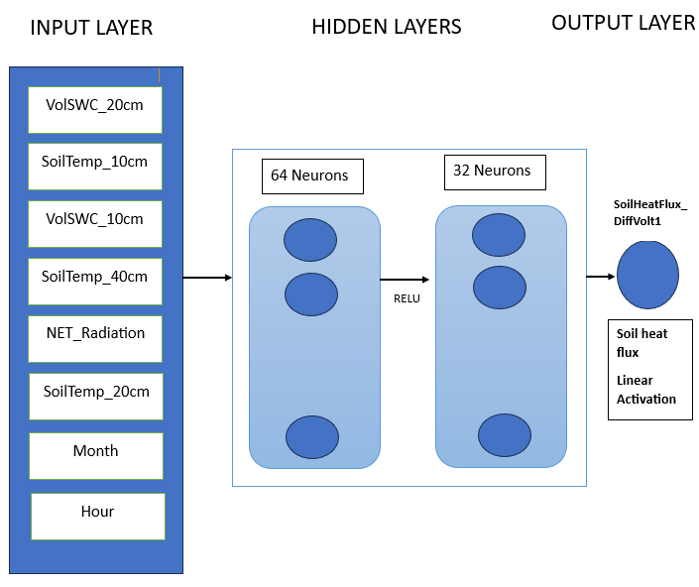






ANN Architecture

Slide 14
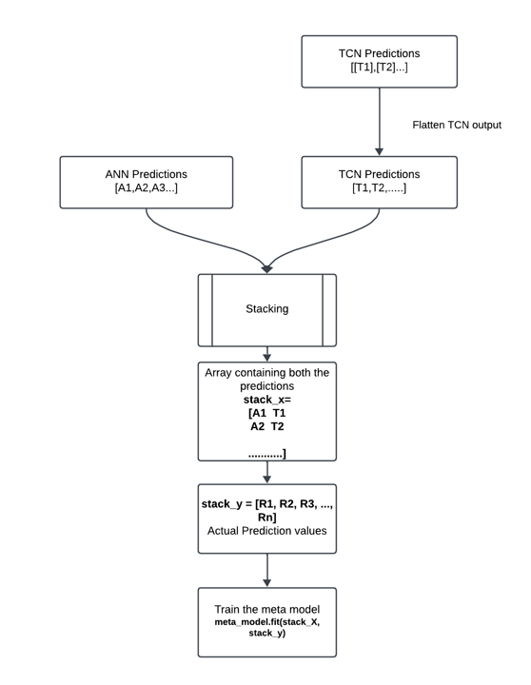
STACKING IN ENSEMBLING

Slide 15
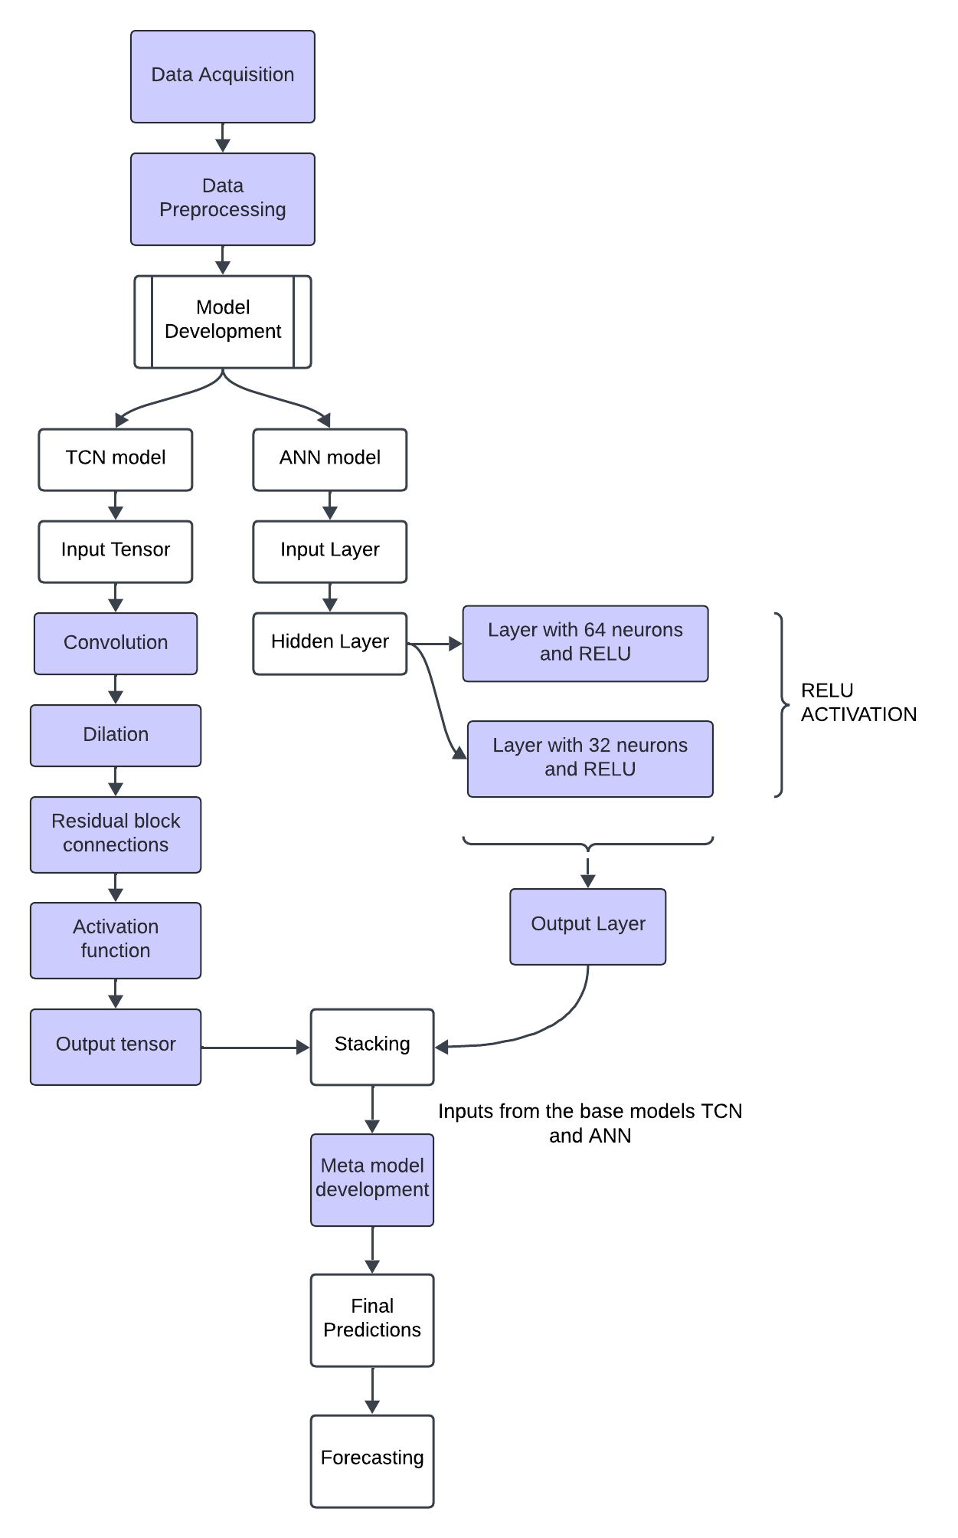
BASIC FLOW OF THE ENSEMBLE MODEL

Slide 16
RESULTS - PERFORMANCE METRICS

Slide 17
Performance metrics
MSE
Epochs | ANN | TCN | LSTM | TCN + ANN
100 | 0.2885 | 3.9944 | 4.6438 | 0.1713
75 | 0.3060 | 9.1605 | 10.297 | 0.1729
50 | 0.4318 | 3.4131 | 6.314 | 0.1559
25 | 0.3305 | 3.7179 | 5.7047 | 0.1563
10 | 0.4456 | 3.7188 | 5.1142 | 0.1468
MAE
Epochs | ANN | TCN | LSTM | TCN+ANN
100 | 0.4124 | 1.4298 | 1.9296 | 0.2901
75 | 0.4151 | 2.4254 | 2.8705 | 0.2866
50 | 0.4226 | 1.3366 | 1.9662 | 0.2935
25 | 0.4664 | 1.3659 | 1.8584 | 0.2948
10 | 0.4778 | 1.3498 | 1.6724 | 0.2834

Slide 18
Performance metrics
R^2 (%)
Epochs | ANN | TCN | LSTM | TCN+ANN
100 | 93.56 | -0.3619 | -0.5833 | 94.16
75 | 85.26 | -3.1234 | -2.5109 | 94.10
50 | 90.97 | -0.1637 | -1.1528 | 94.69
25 | 92.70 | -0.2676 | -0.9451 | 94.67
10 | 91.09 | -0.2679 | -0.7437 | 93.57

Slide 19
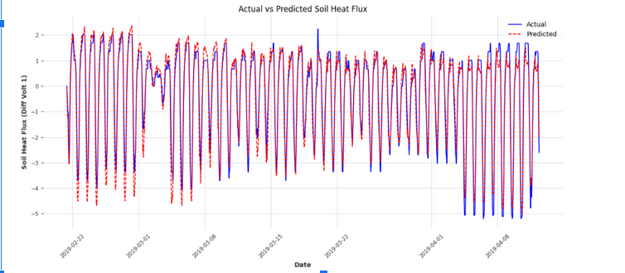
Results - Plots
ANN Predictions for Validation set

Slide 20
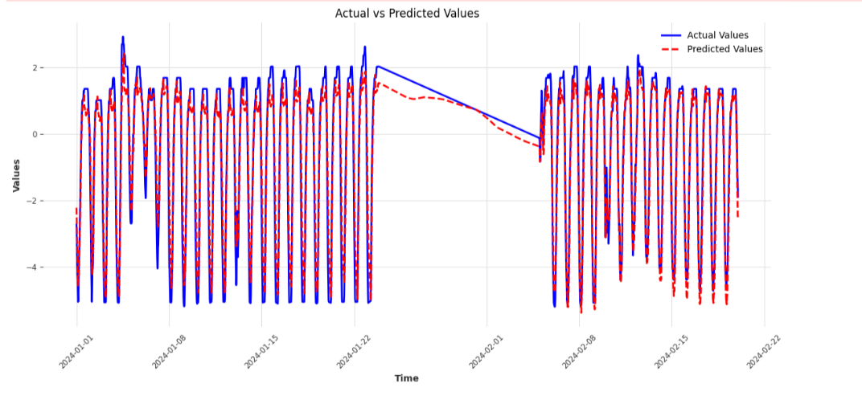
ANN Predictions for Testing set
ACCURACY : 93.56%

Slide 21
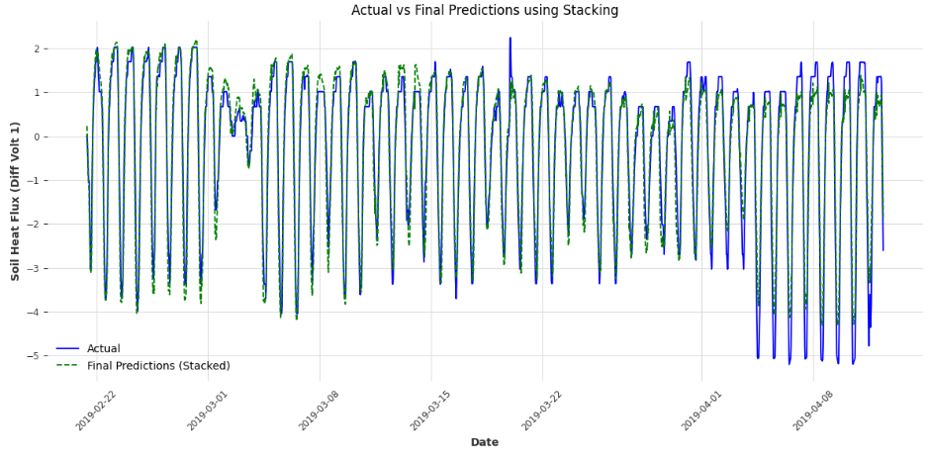
TCN+ANN Predictions
Validation set

Slide 22
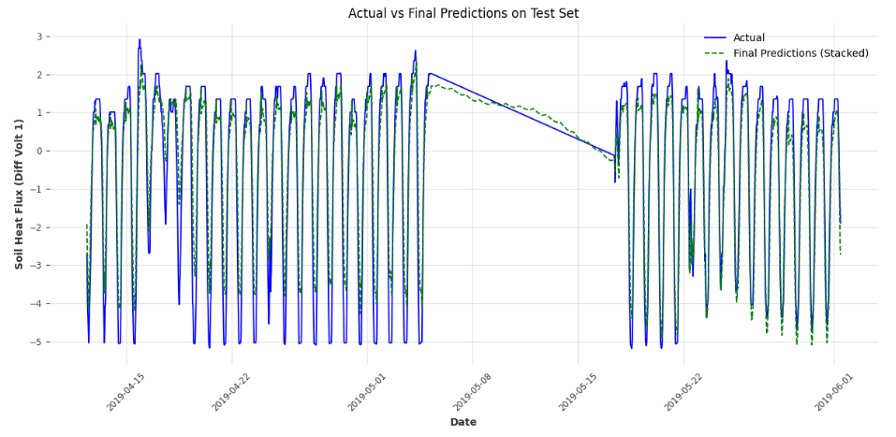
Testing set

Slide 23
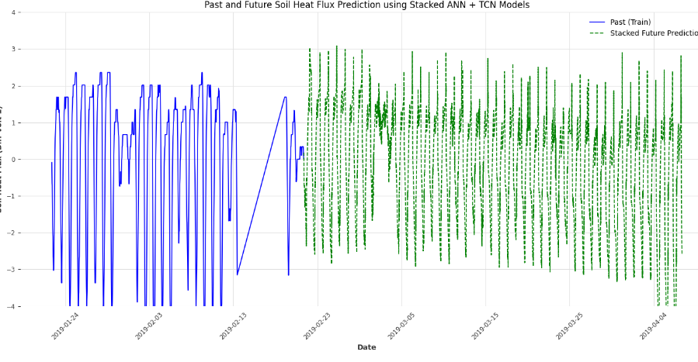
Future Predictions

Slide 24
Thank you!

